Slide 1
Data Structures ICT-1211 Information and Communication Technology
Lecture-26
Date: //2024

Slide 2
TREES

Slide 3
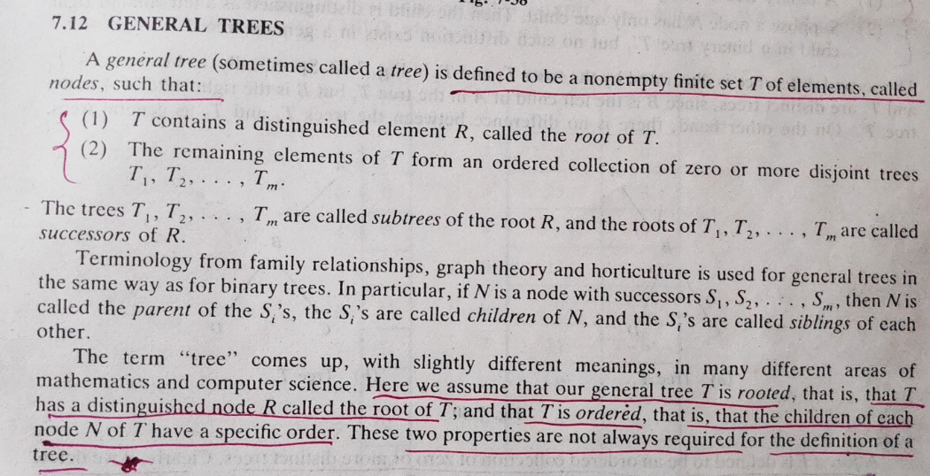
General Tree

Slide 4
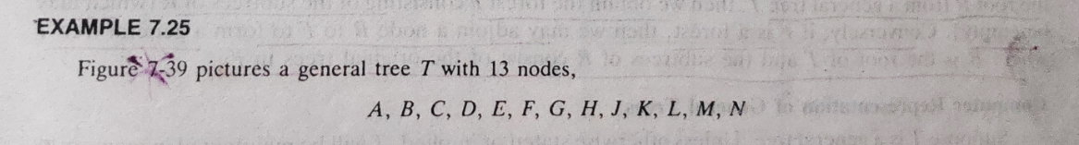
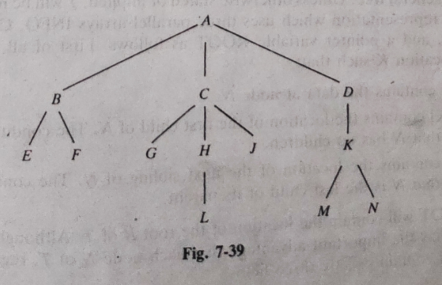
General Tree

Slide 5
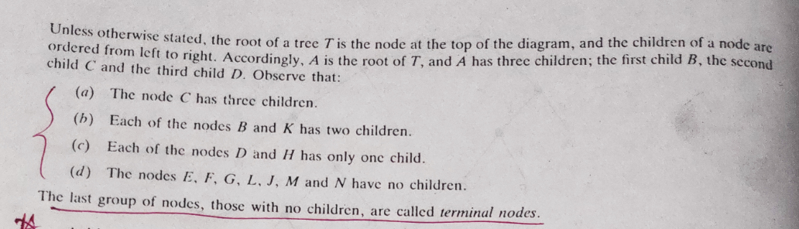
General Tree

Slide 6
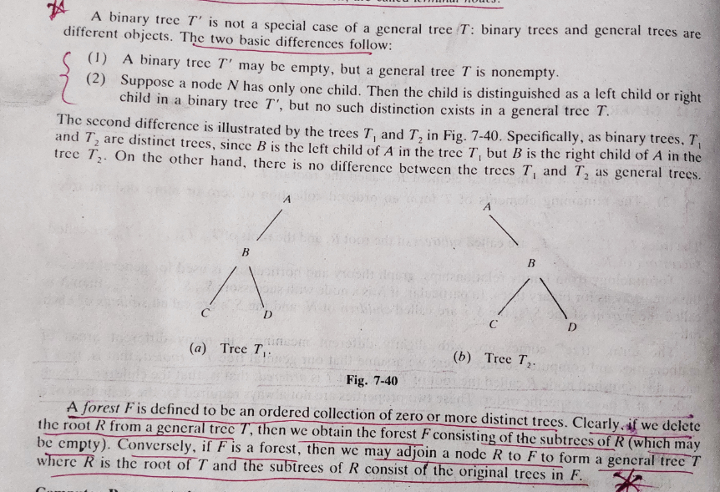
General Tree

Slide 7
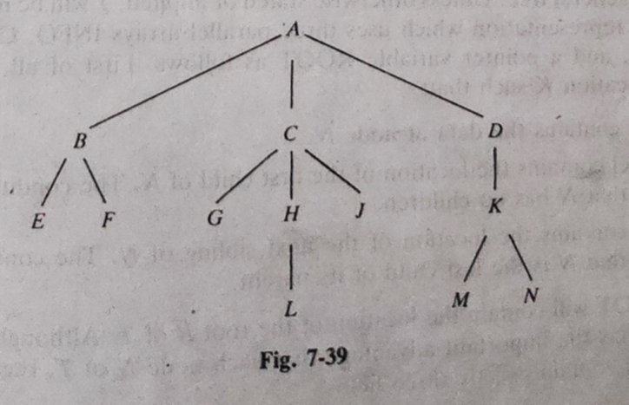
General Tree to Binary Tree
A
B

Slide 8
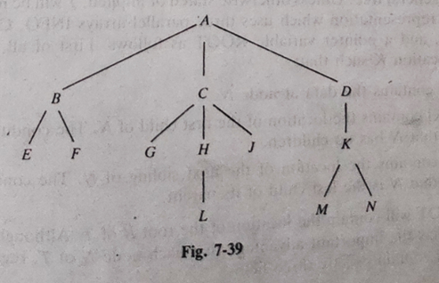
General Tree to Binary Tree
A
B
C
D

Slide 9
General Tree to Binary Tree
B
E
F
A
C
D

Slide 10
General Tree to Binary Tree
B
E
F
A
C
D
G
H
J

Slide 11
General Tree to Binary Tree
A
B
E C
F G
H
J
D
K

Slide 12
General Tree to Binary Tree
A
B
E C
F G
H
J
L
D
K

Slide 13
General Tree to Binary Tree
A
B
E C
F G
H
J
L
D
K
M
N

Slide 14
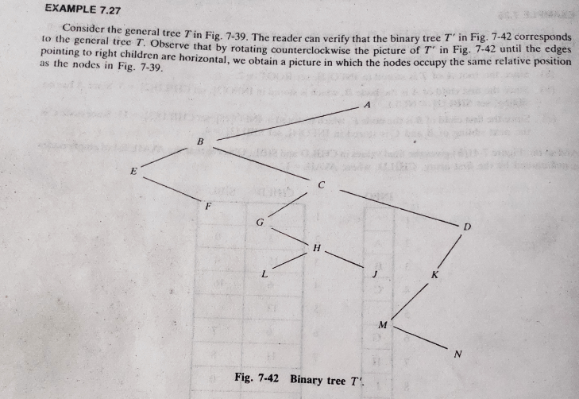
General Tree to Binary Tree

Slide 15
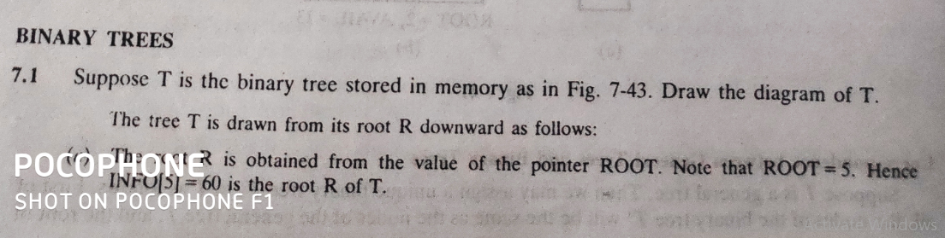
Solved Problems

Slide 16
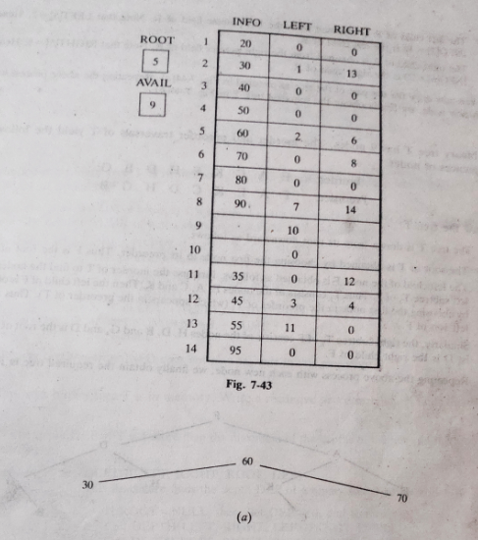
Solved Problems

Slide 17
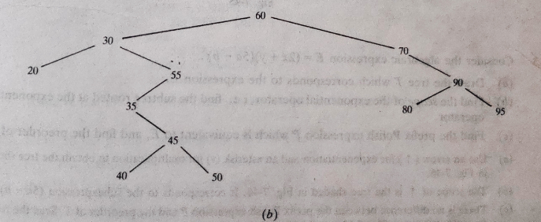
Solved Problems

Slide 18
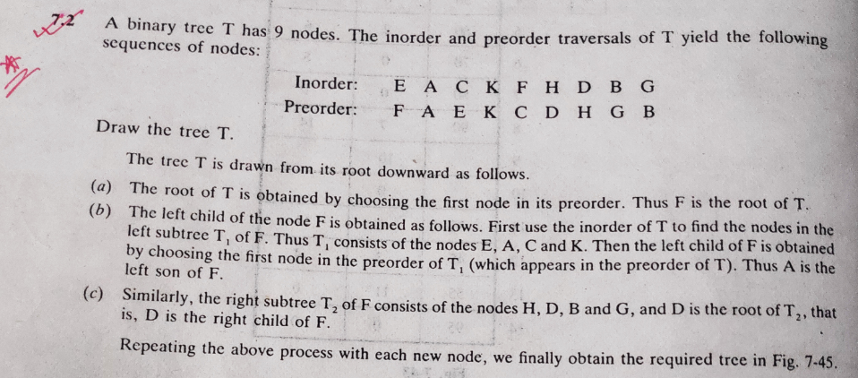
Solved Problems

Slide 19
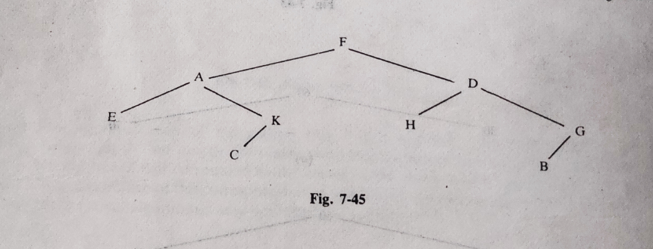
Solved Problems

Slide 20
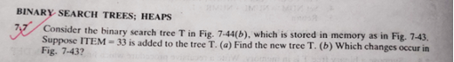
Solved Problems

Slide 21
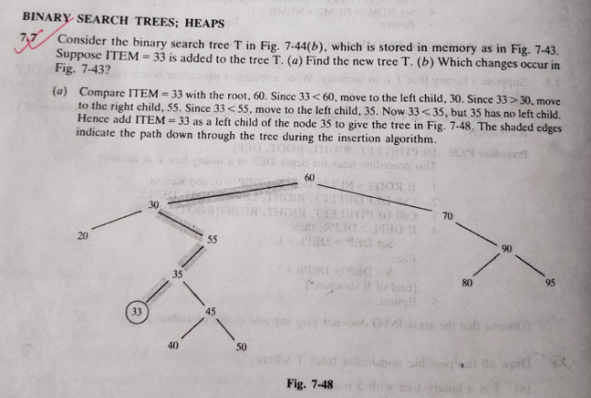
Solved Problems

Slide 22
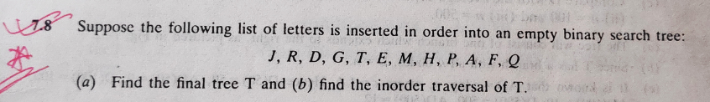
Solved Problems

Slide 23
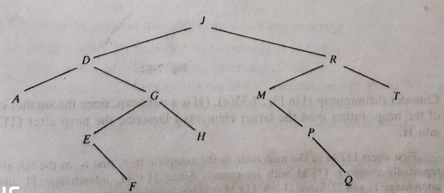
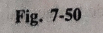
Solved Problems

Slide 24
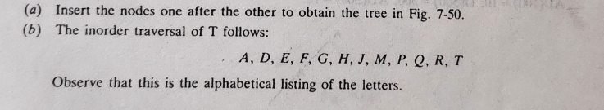
Solved Problems

Slide 25
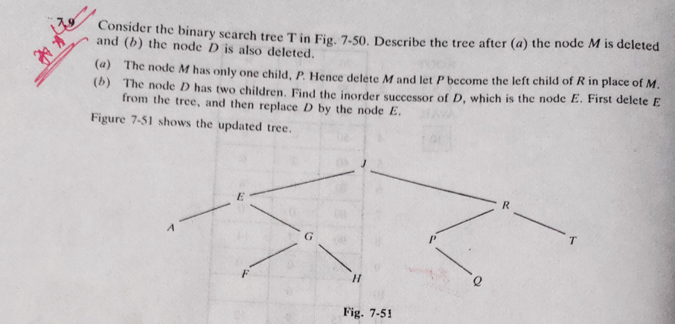
Solved Problems

Slide 26
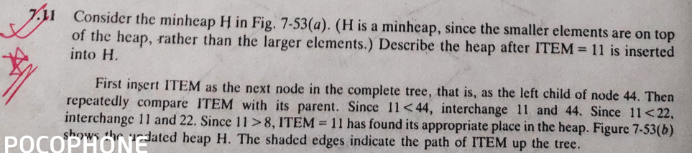
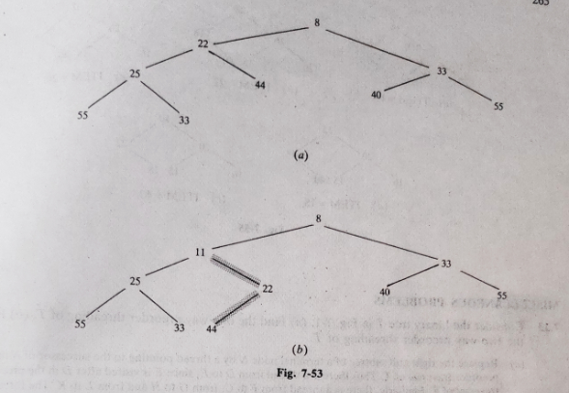
Solved Problems

Slide 27
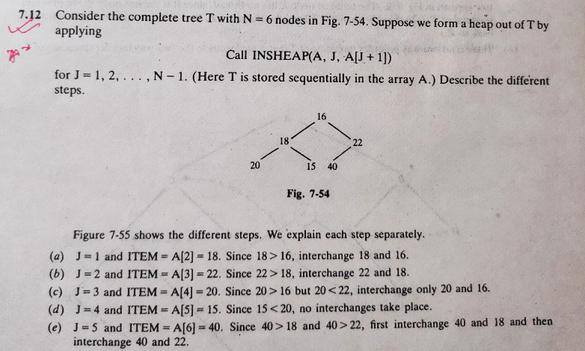
Solved Problems

Slide 28
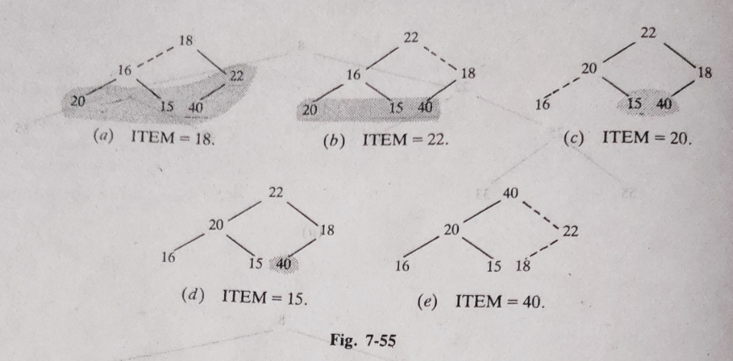
Solved Problems

Slide 29
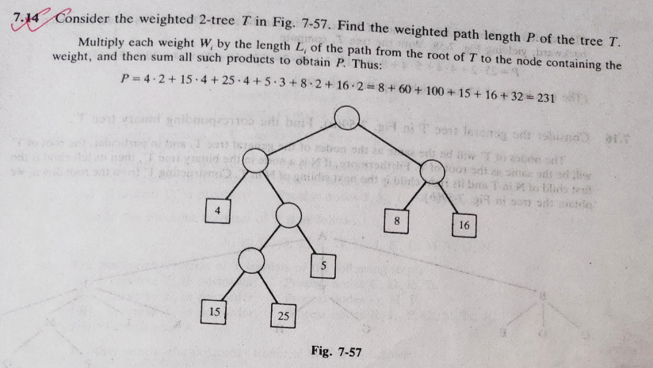
Solved Problems

Slide 30
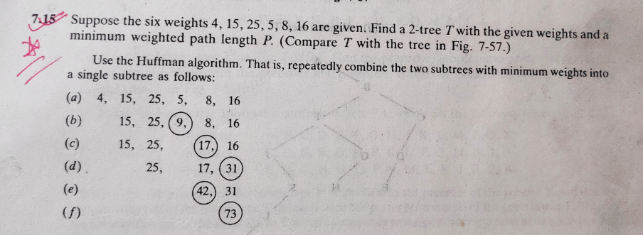
Solved Problems

Slide 31
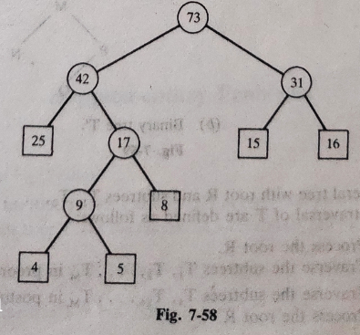
Solved Problems

Slide 32
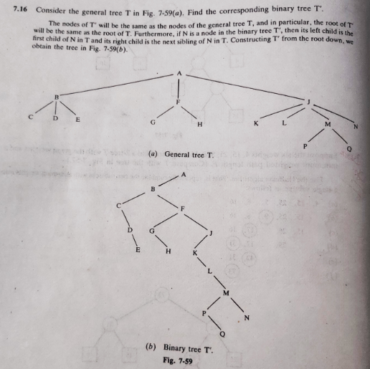
Solved Problems

Slide 33
Thank you……

